Slide 1
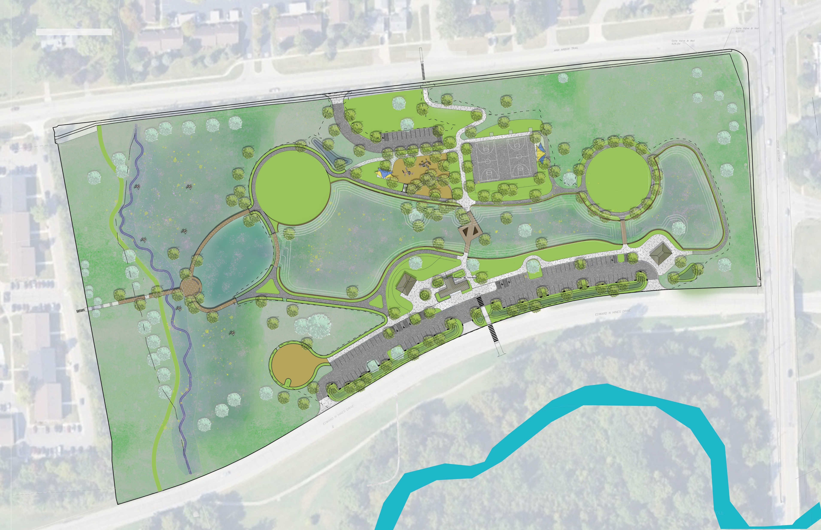





Perrin Park Habitat Restoration Design
October 2026

Slide 2

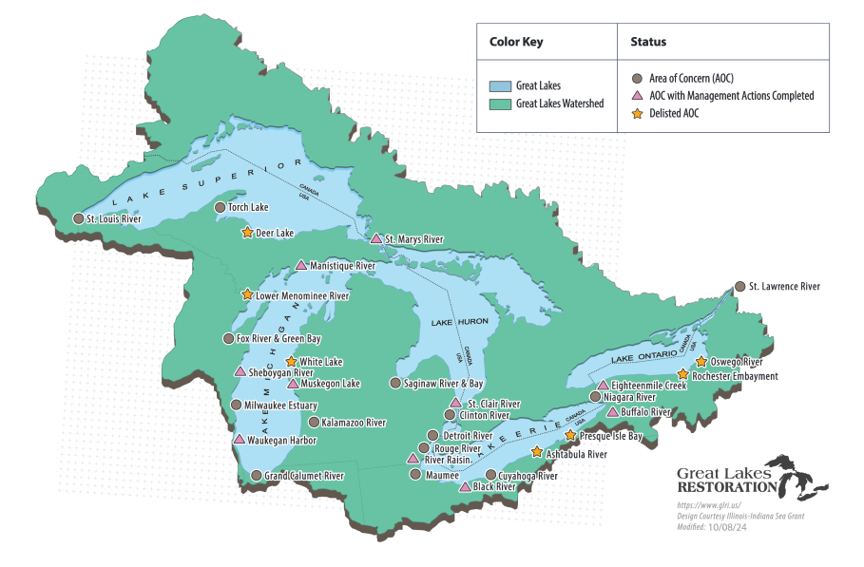
U.S. Great Lakes Area of Concern
    1987: AOCs identified
    1992 – 2014: Rouge Project
    2005: ARC formed
    2008: Projects identified
    2010: Great Lakes Restoration Initiative (GLRI) established, ARC receives its first GLRI funding
    2014: Habitat BUI List
    2010 – 2025: ARC utilizes $30M+ to complete 30+ restoration projects

Slide 3
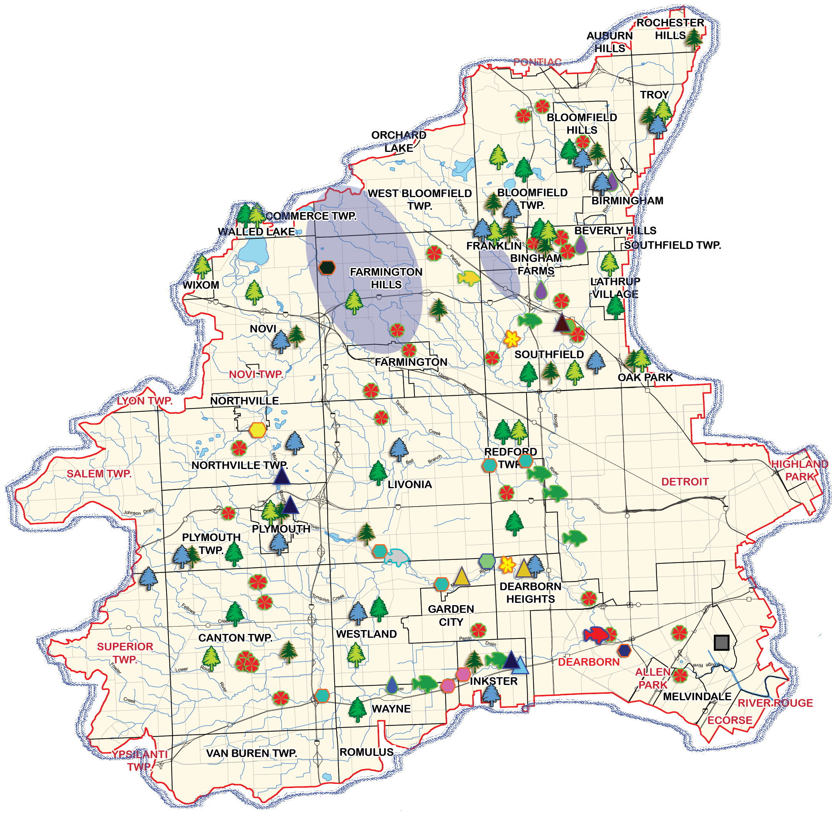
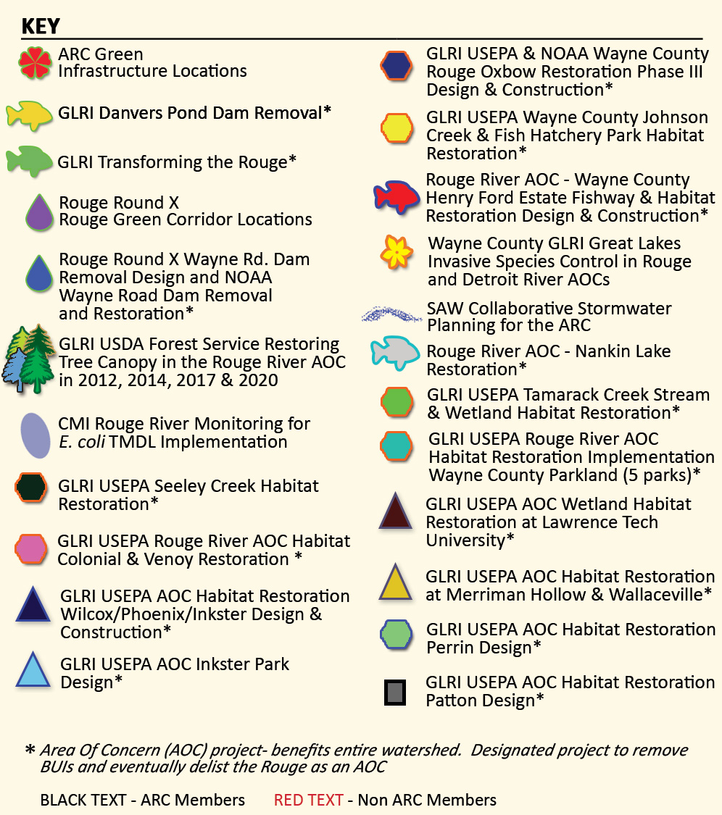
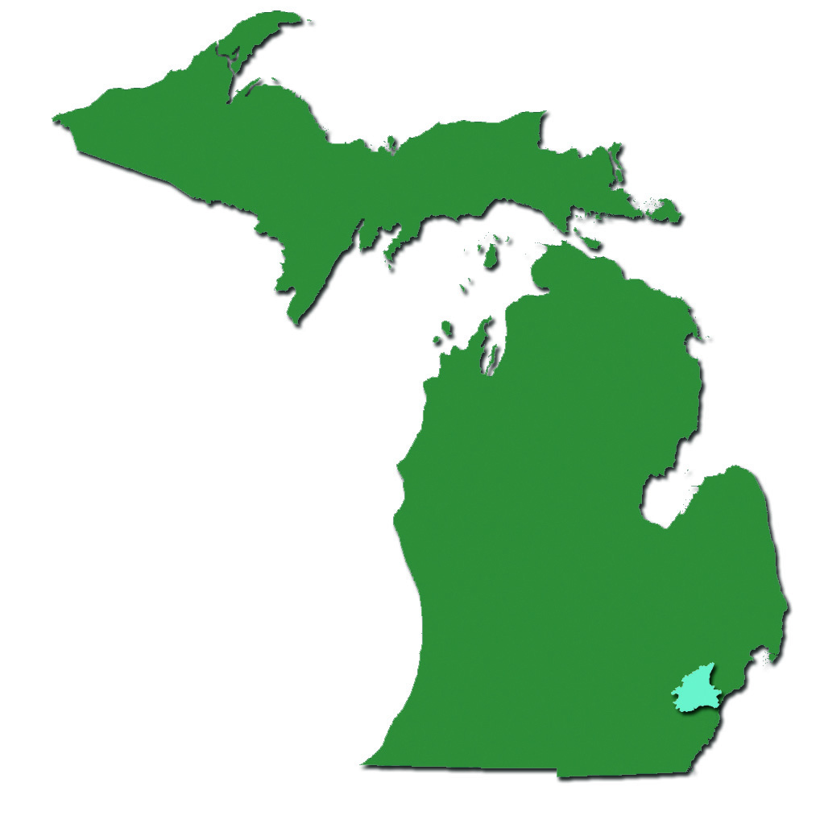
ARC Grant Projects

Slide 4
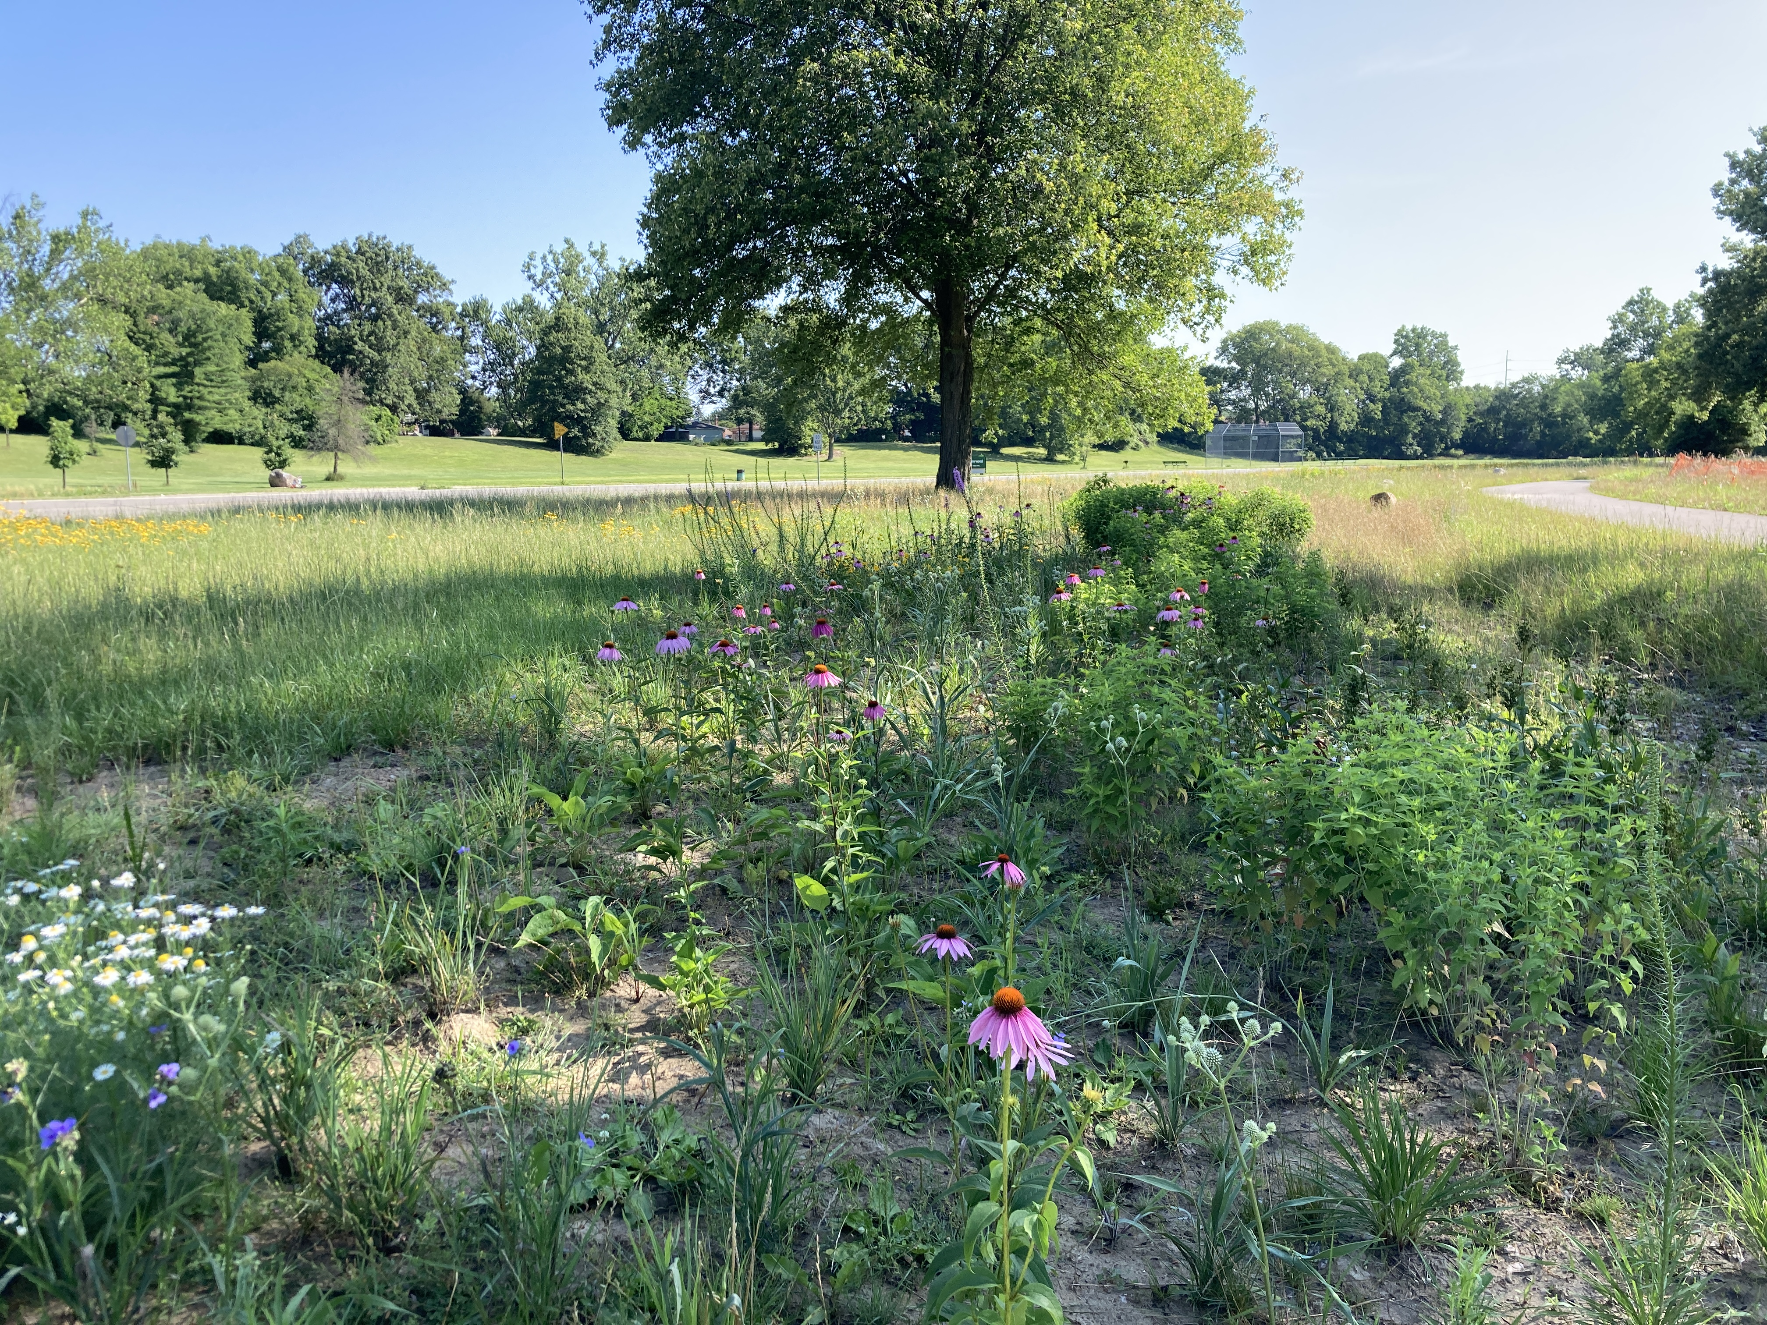
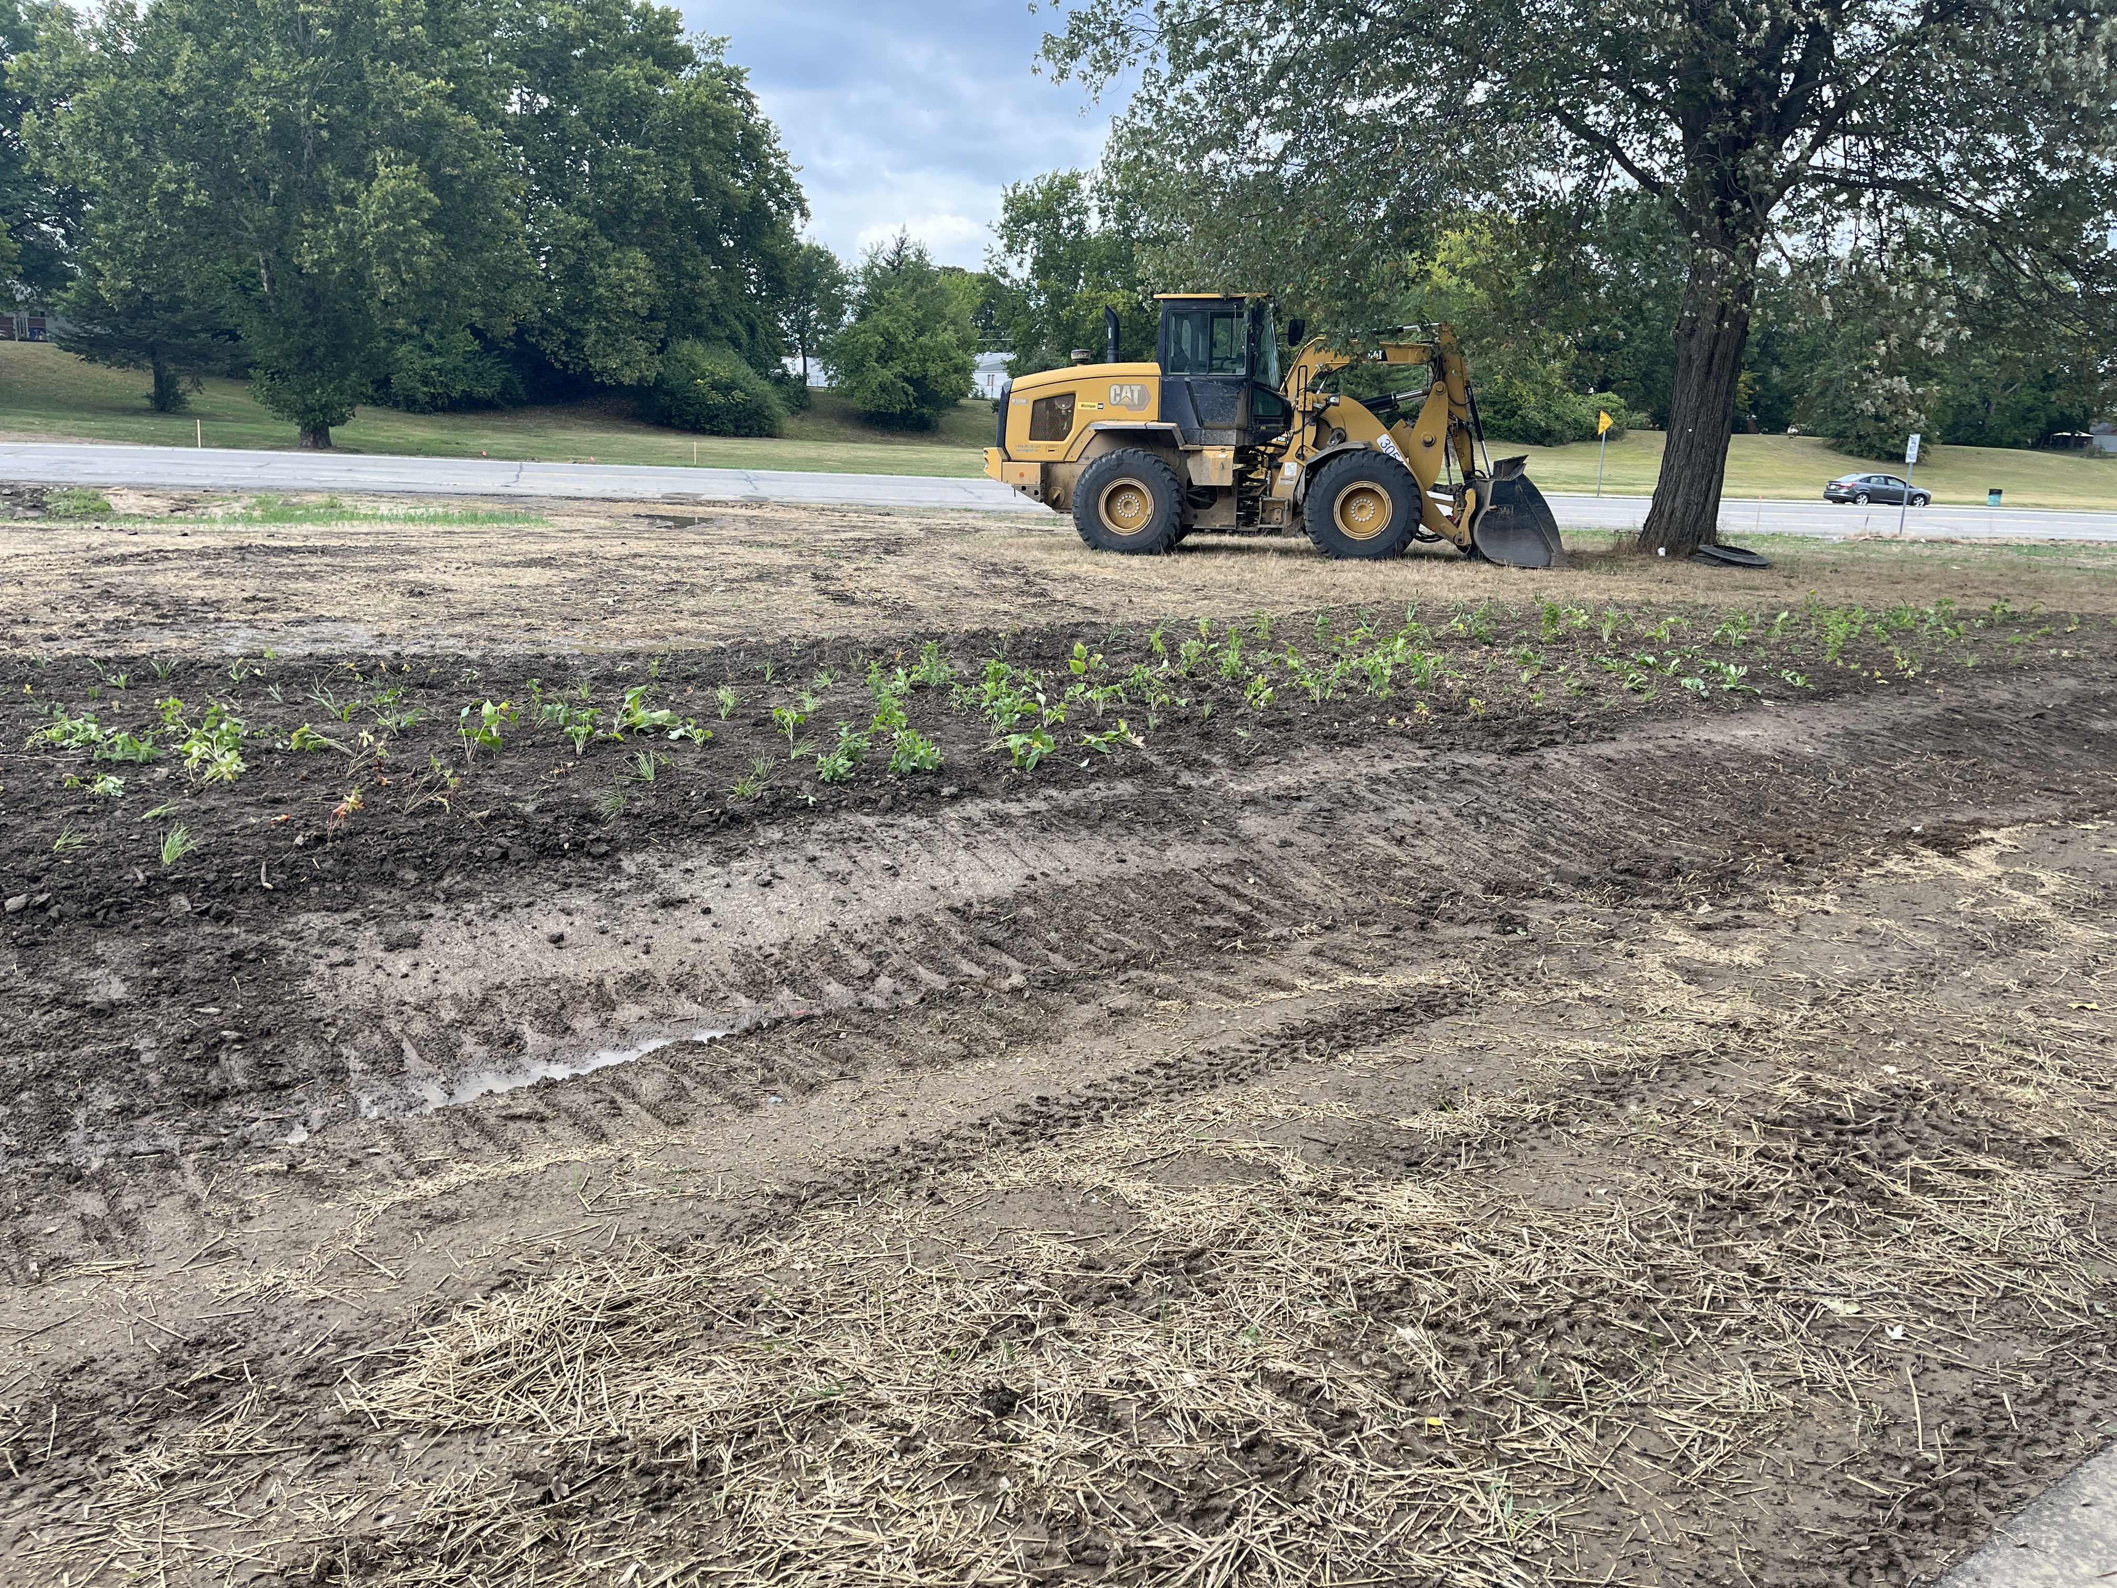
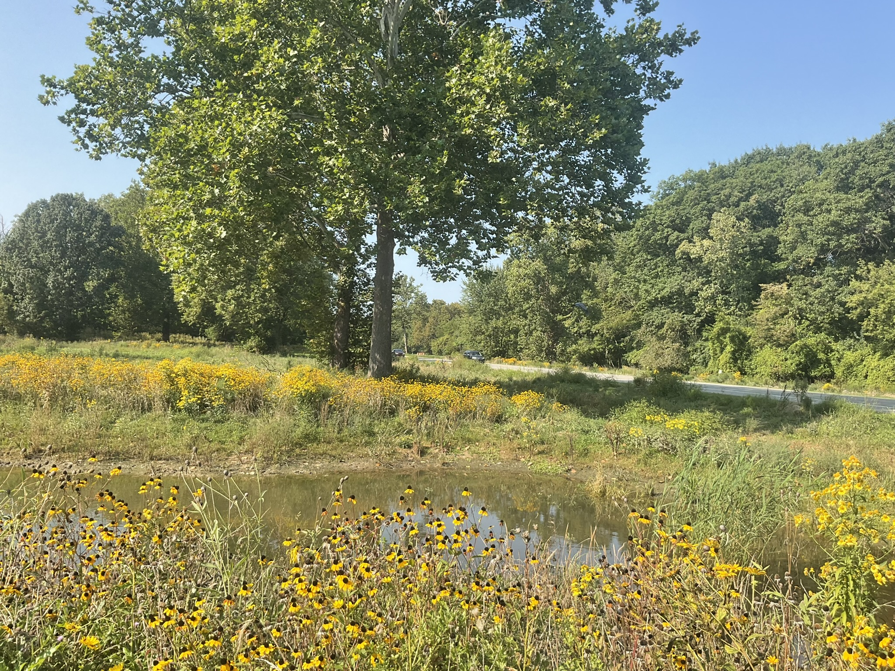
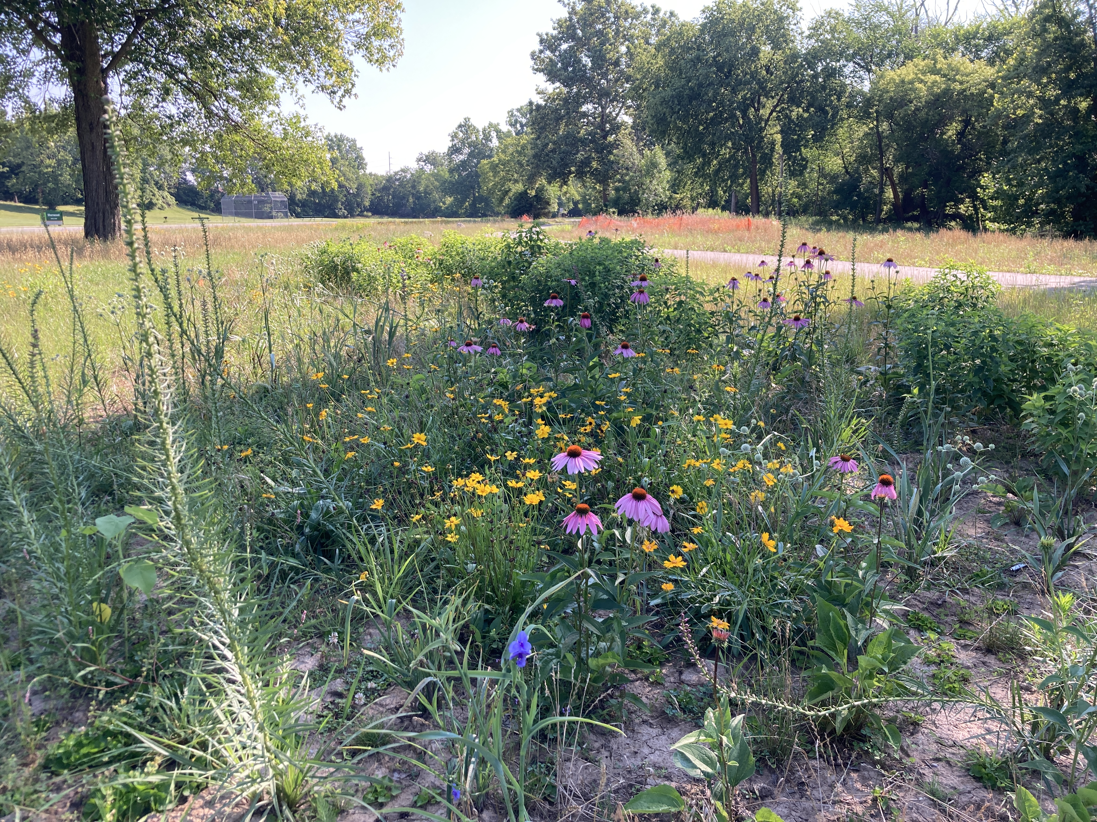
Restoration in Westland
Sherwood Park
6.8 acres habitat creation/restoration
  Wetland creation/restoration
  Conversion of maintained lawn to native wet meadow
  Riparian invasive species treatment

Slide 5
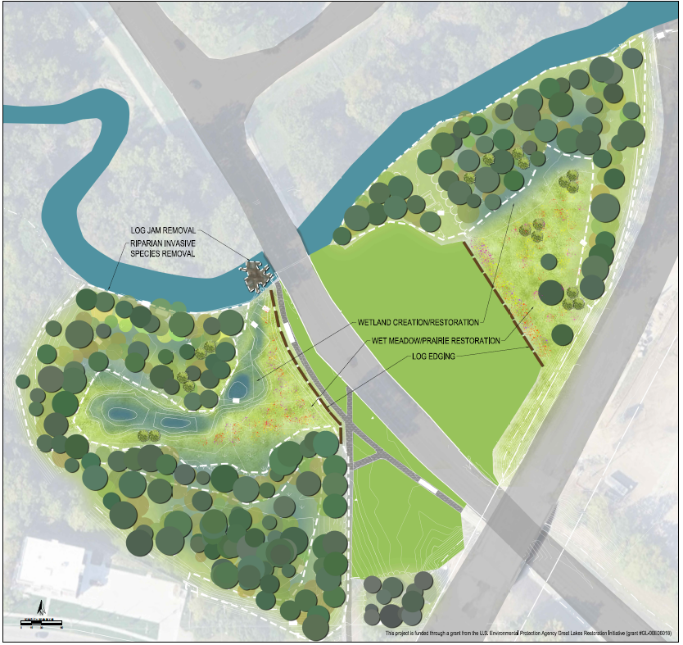
Restoration in Westland
Merriman Hollow Park
(Under Construction)
4.4 acres habitat creation/restoration
  Wetland creation/restoration
  Conversion of maintained lawn to native wet meadow/prairie
  Riparian invasive species treatment

Slide 6



Project Partners and Roles
US Environmental Protection Agency: Great Lakes National Program Office- Funding (Great Lakes Restoration Initiative)
Alliance of Rouge Communities (ARC) – Grant/Project Owner
Wayne County Parks – Landowner/ARC Community Member
City of Westland – ARC Community Member
Rouge River Advisory Council – Local PAC
Friends of the Rouge – Local Non-Profit
Environmental Consulting & Technology, Inc. (ECT) – Engineer

Slide 7
Perrin Park Restoration Grant
2024 EPA GLRI Habitat Design Grant GL00E03805
(2024- 2026) - $453,250
  Preliminary Engineering
  Field Investigations
  Restoration Design
  Permitting

Slide 8
Upland Prairie
  Native plants, plugs and trees
  Diversity of flowering plants that provide food for pollinators
Habitat Plan
Wetland Restoration & Creation
  Diversity of water depths
  Native plants
  Wading birds, waterfowl, & amphibians
  Substrate and aquatic vegetation for egg-laying
Stream Realignment
  Erosion control
  Flow naturalization
  Channel naturalization

Slide 9
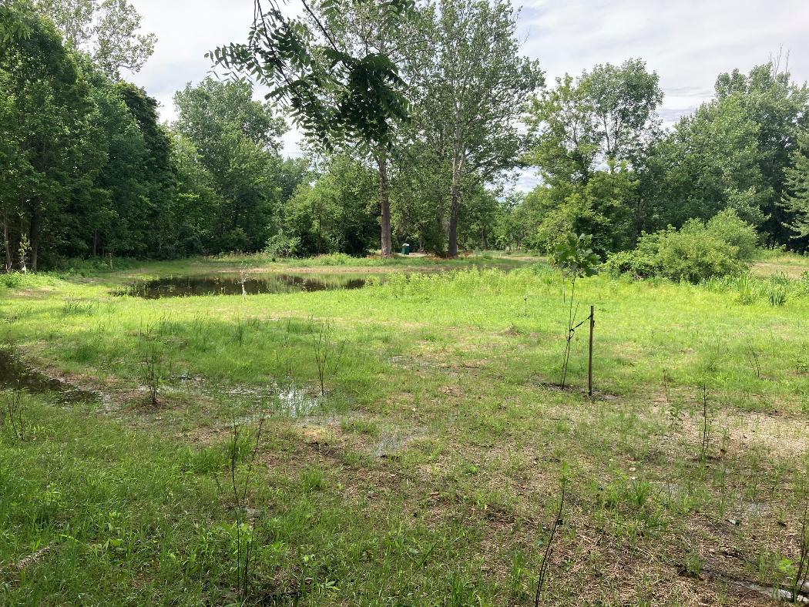
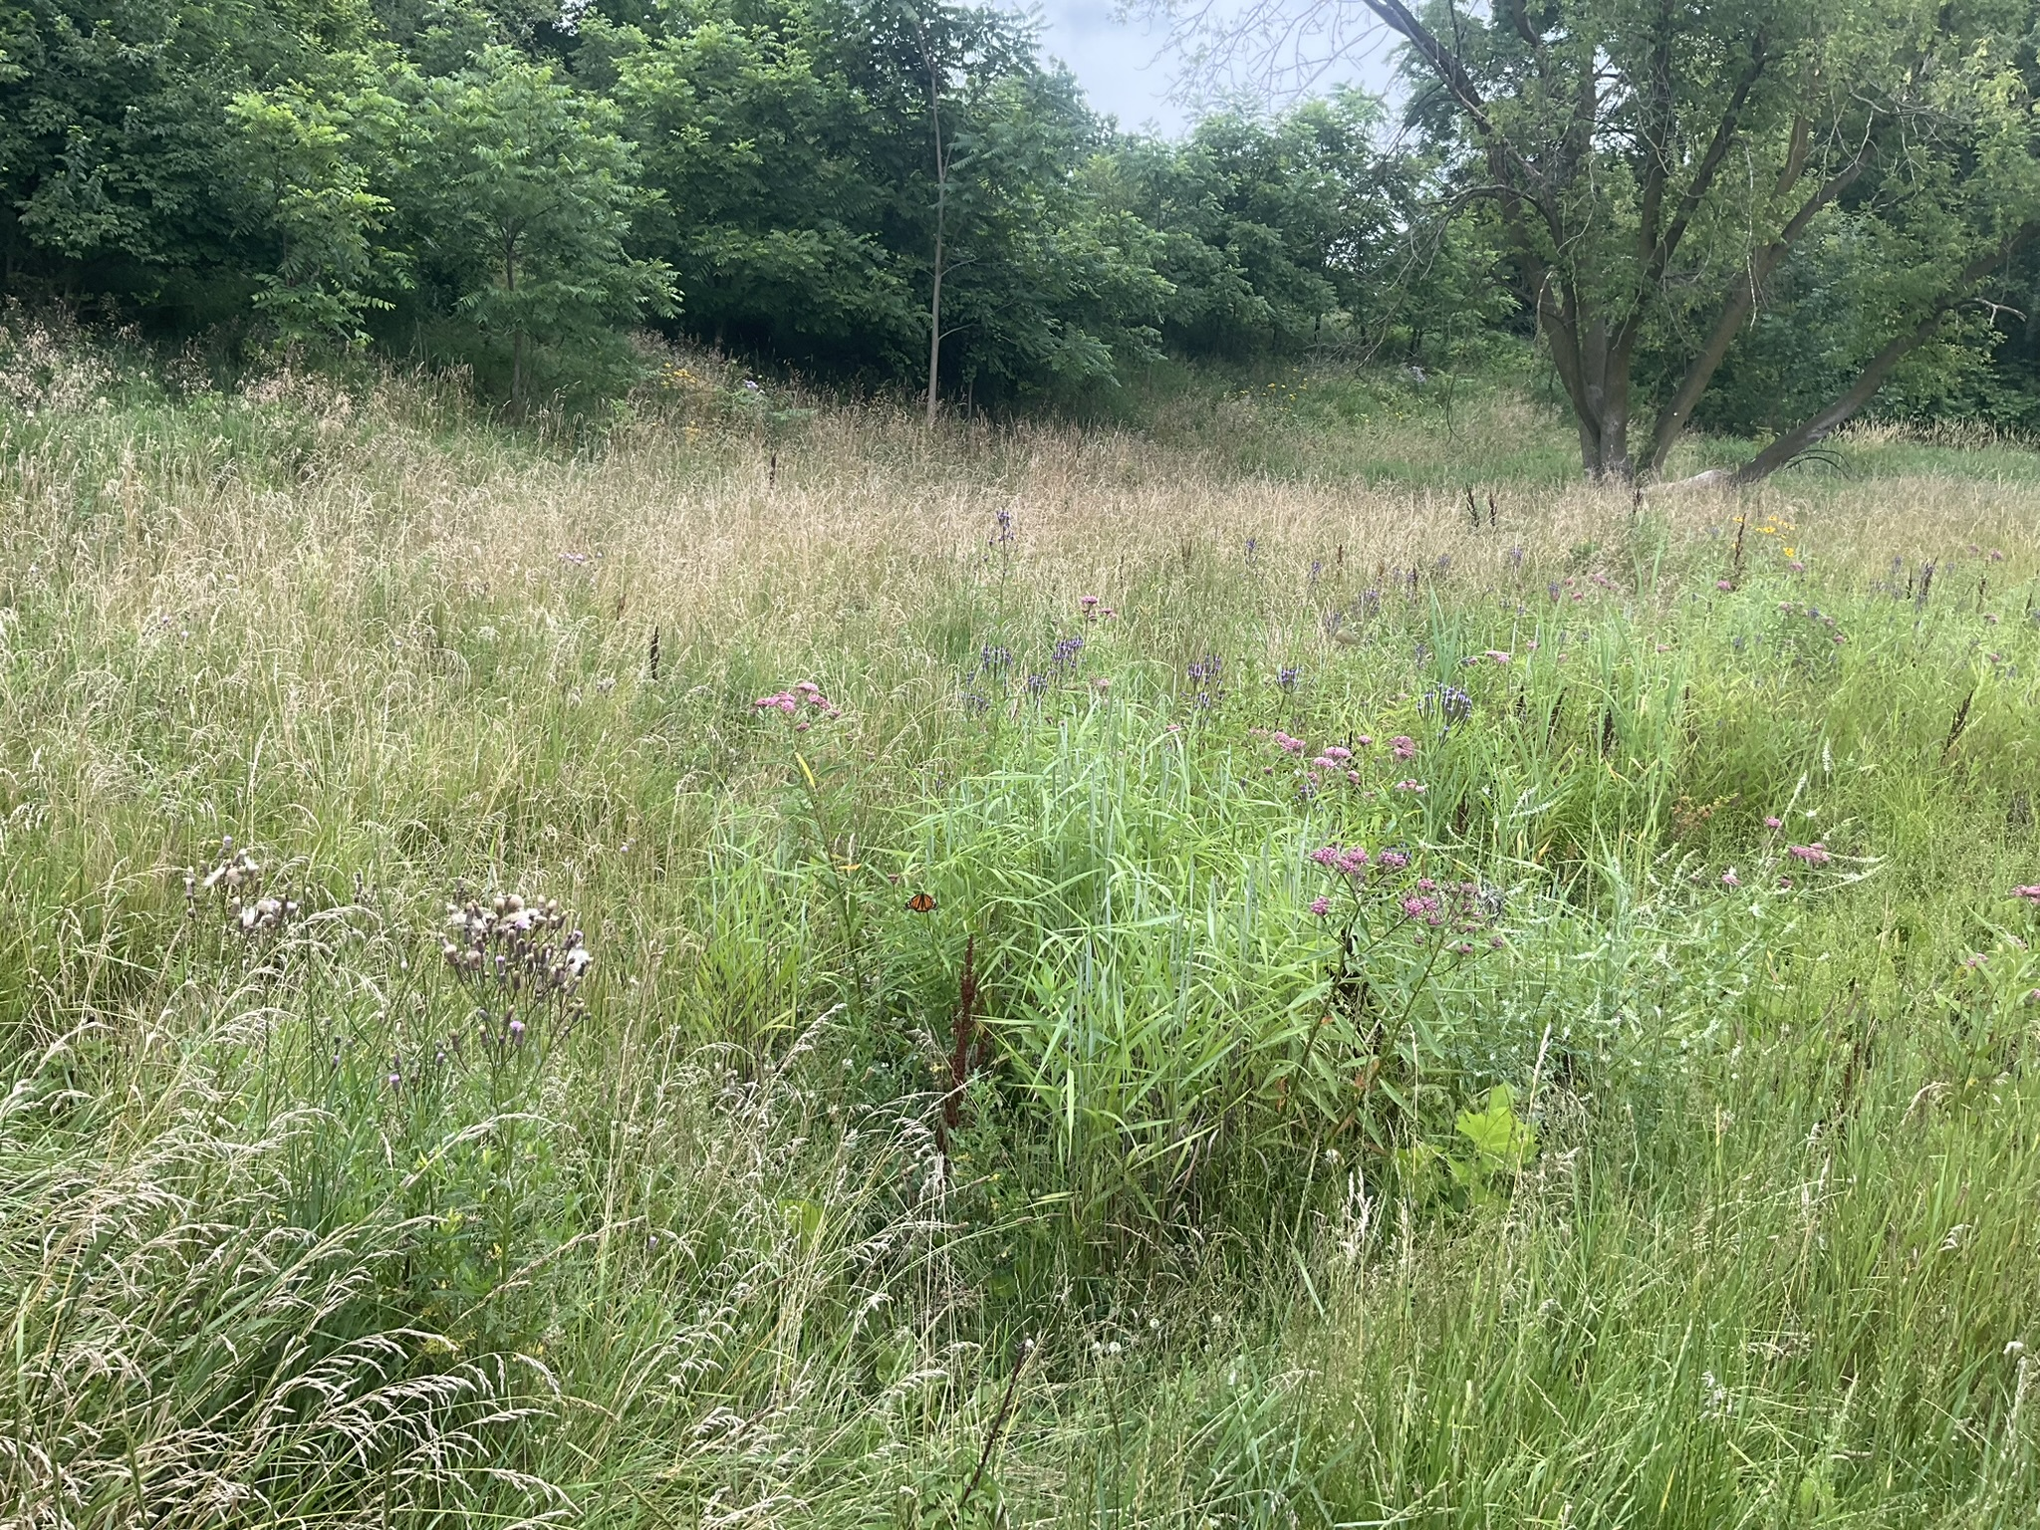
Wetland Habitats

Slide 10
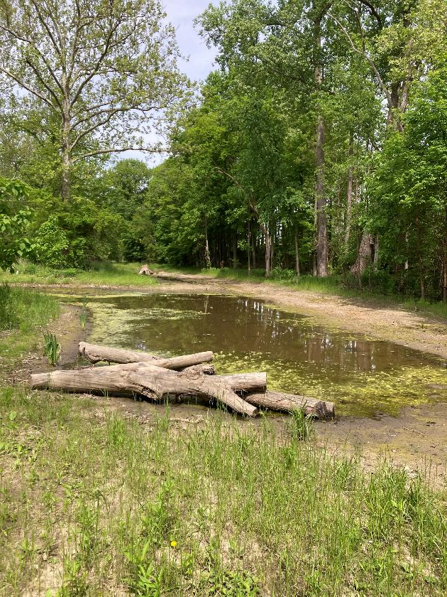
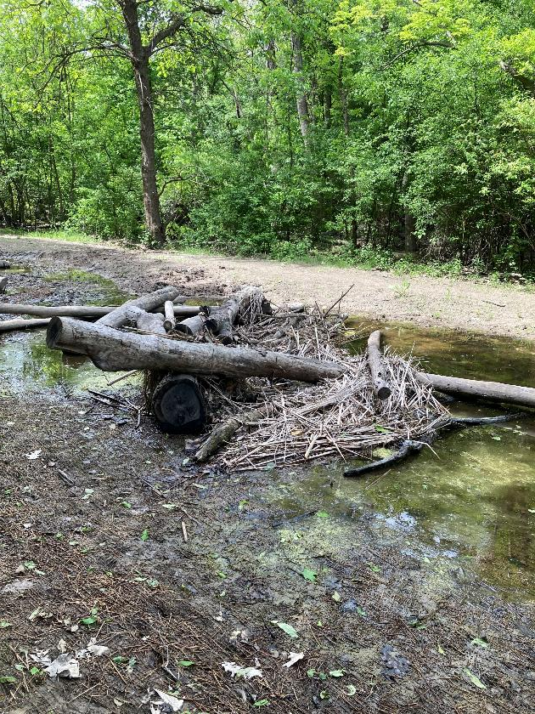
Structural Habitat

Slide 11
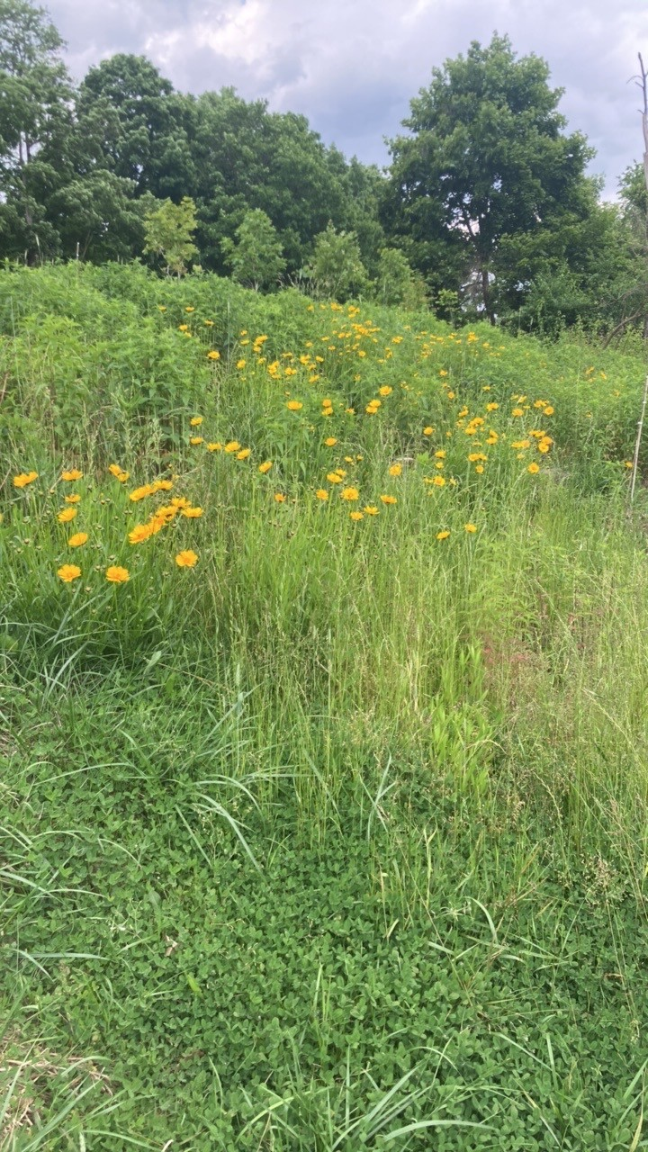
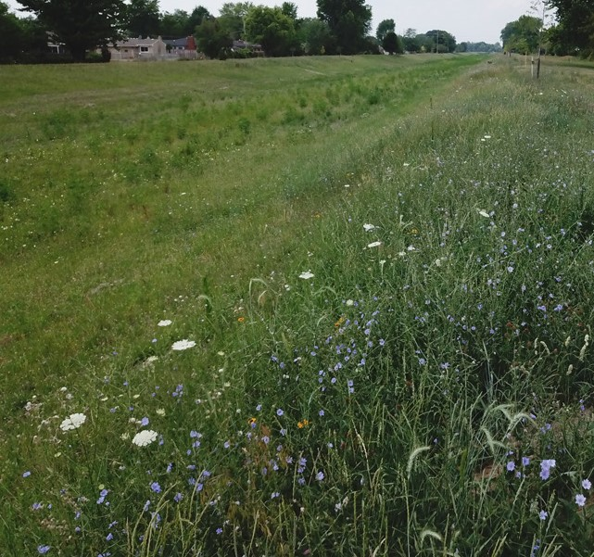
Upland Prairie Habitat

Slide 12
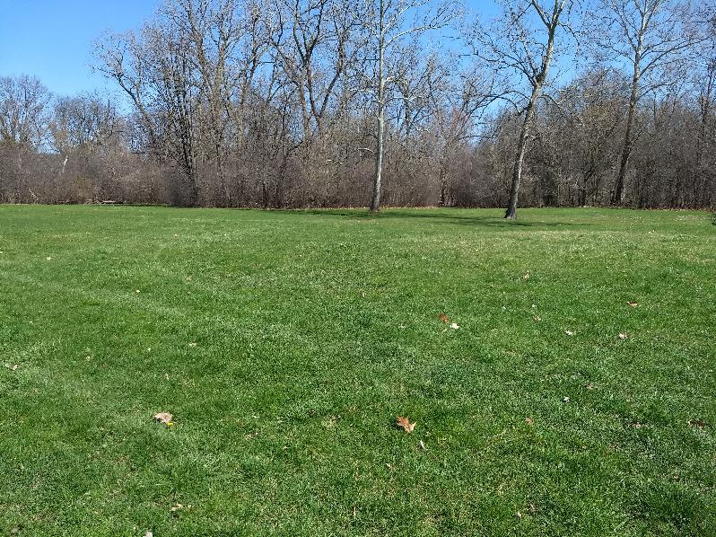
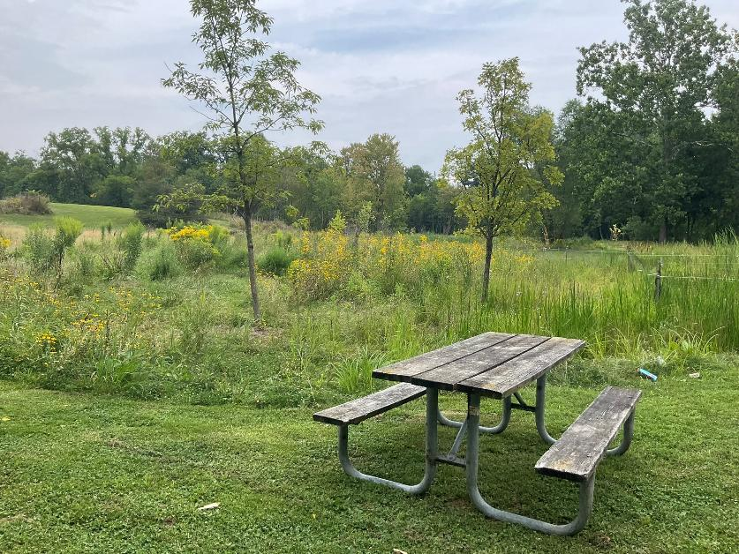
Before/After Ideas

Slide 13
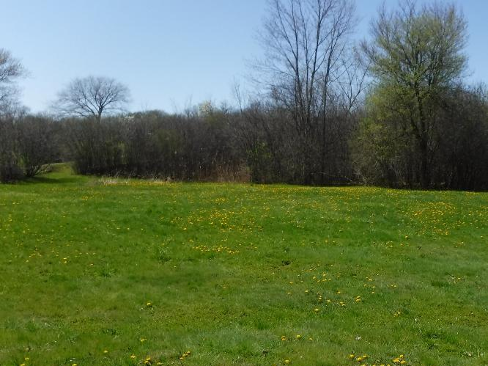
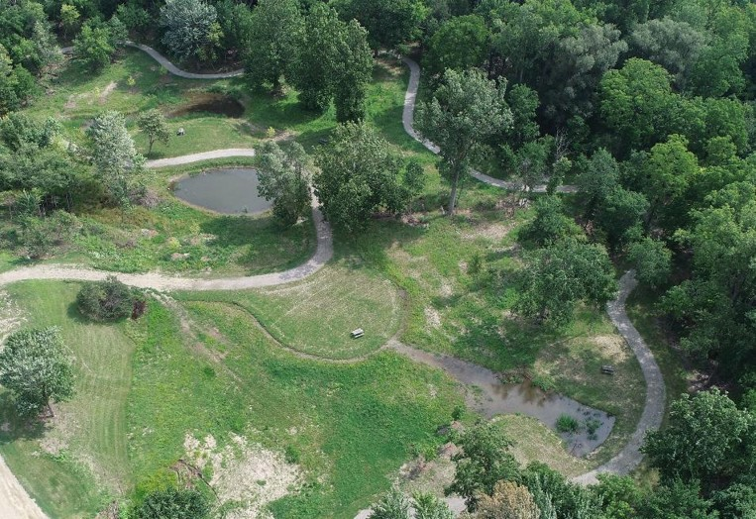
Before/After Ideas

Slide 14
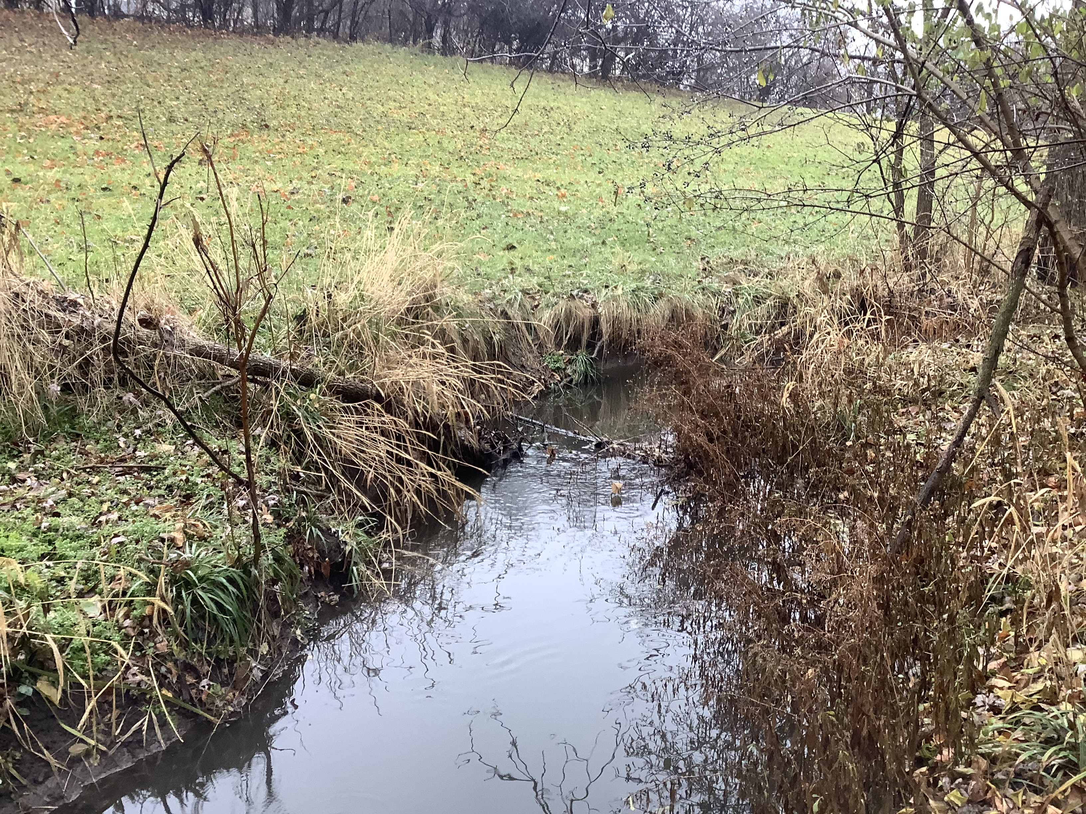
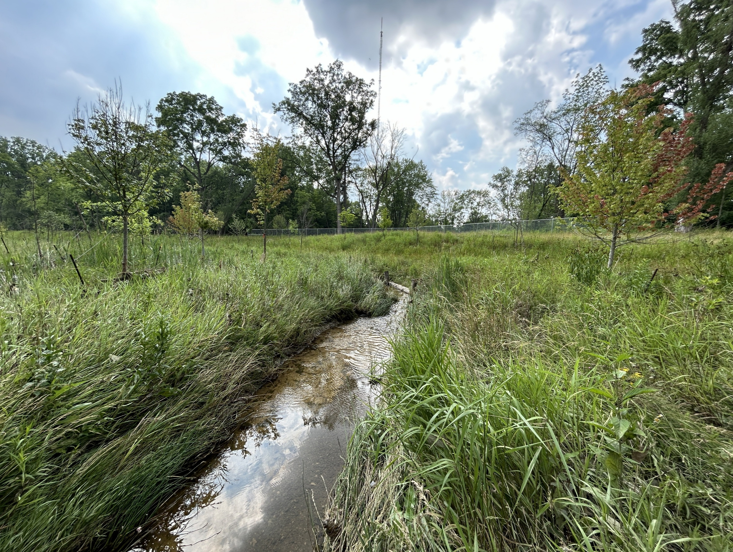
Before/After Ideas

Slide 15
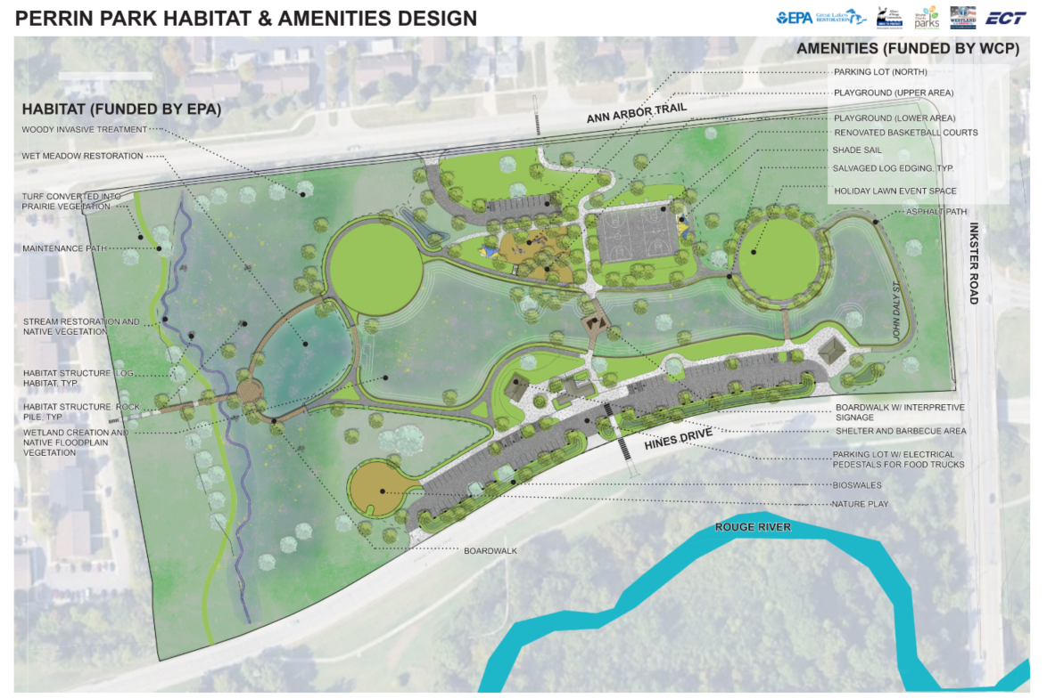

Amenity Design – Overall Plan

Slide 16
Questions?
Thank you!

